Slide 1
The 68000 family

Slide 2
INTRODUCTION
Introduced by Motorola in 1979.
Used in Macintosh systems, gaming applications and embedded applications like laser printers.
68000 and its family are used in networking and telecom equipments, television set-top boxes, laboratory and medical instruments, and even handheld calculators.

Slide 3
ASSEMBLER DIRECTIVES
EQU:- The equate directive links or binds a name to a value, making programs much easier to read.
Eg: STK_FRAME EQU 128
DC:- Define a constant.
permits the programmer to specify a constant that will be loaded into memory before the program executed.
Qualified by .B, .W,or .L to specify constants of 8-bits, 16-bits, or 32-bits
A number(constant) without a prefix is treated as a decimal value.
$ indicates hexadecimal value
% indicates binary value
Eg: DC.B 10,66
DC.L $0A1234

Slide 4
DS:- Define storage
Reserve storage locations
Assembly language form is
Label DS.<size> <operand>
DS is qualified by the size parameters .B, .W, or .L
Similar to DC but no information is stored in memory
Eg: list1 DS.B 4
pointer DS.L 16
Table DS.W 256
ORG:- Origin
Value of the location counter that keeps track of where the next item is to be located in the target processors memory.
Eg: ORG 001000
END:- end
End of a program

Slide 5
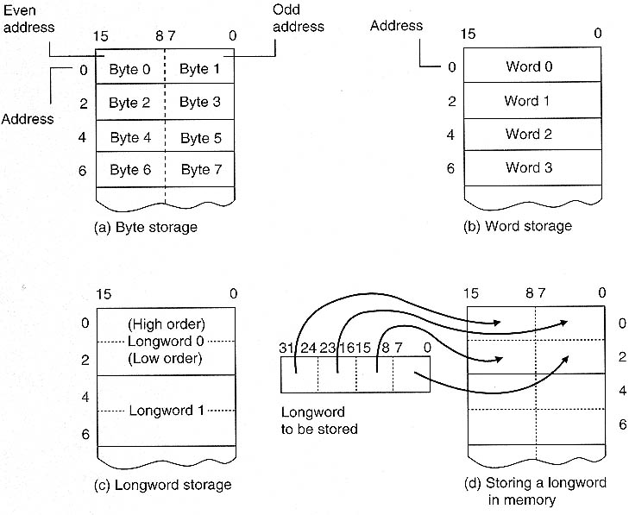
Memory Organization

Slide 6
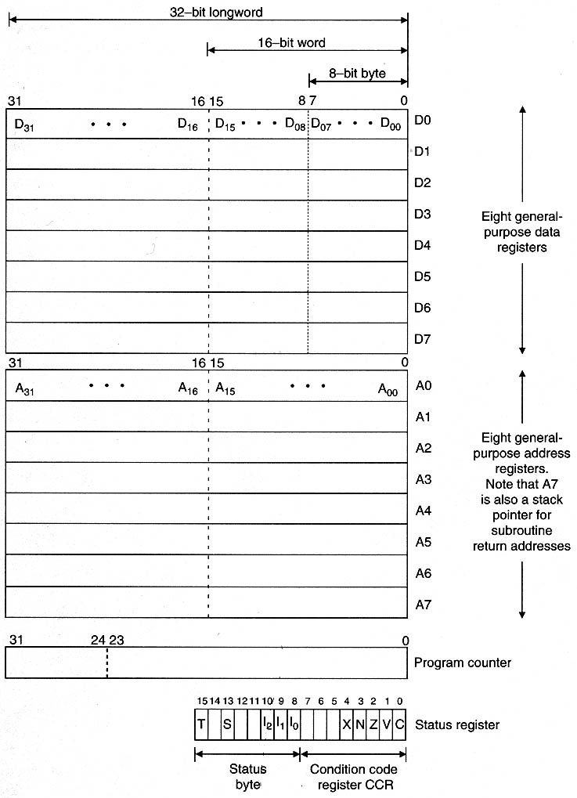
68000 architecture

Slide 7
Registers are divided into 3 groups
a)Data b)Address c)Special purpose
32 bit registers and can carry out 32-bit operations on data or address.
But 68000 is interfaced to external systems by a 16-bit data
bus,forcing all 32-bit accesses to be implemented as 2
consecutive accesses.
Addr bus is only 24-bits wide,hence A24-A31 has no effect.
(addr are written as 6 hex characters instead of 8)
8 general purpose data registers(D0-D7) .
- reg are general in the sense that any operation in Di is
permitted to Dj.
Ex:ADD.B D0,D1 (D1←D1+D0)

Slide 8
8 addr reg,A0-A7 and each reg is a pointer register.
Byte operations on bits 0 -7 of an addr reg is not permitted.
A7 is a special-purpose addr reg which acts as stack pointer.
68000 runs in 2 modes
a)Supervisor mode:OS runs in this mode.
b)User Mode:Pgms controlled by OS runs in this mode.
Each mode has its own A7 ,SSP and USP.
If a user corrupts his USP,the entire system will not crash as we will have a separate SSP for OS.
2 special purpose reg
a) Program Counter(PC) b)Status Register(SR)

Slide 9
Program Counter(PC):32 bits wide and contain the addr of the
next instrn to be executed.(only 24 bits useful)
-enables look-ahead.
Status Register(SR): divided into 2 logical fields
a)System Bytes: 8 MSB bits that controls operating mode.
5 bits:T,S,I₀,I₁ and I₂
Cant be modified by programmer running in user mode.
b)Condition Code Register:LSB which indicates outcome of
arithmetic and logical instrns.
Consider the operation ADD.B D0,D1 if [D0]=$12345678 ,
[D1]=$13579B57

Slide 10
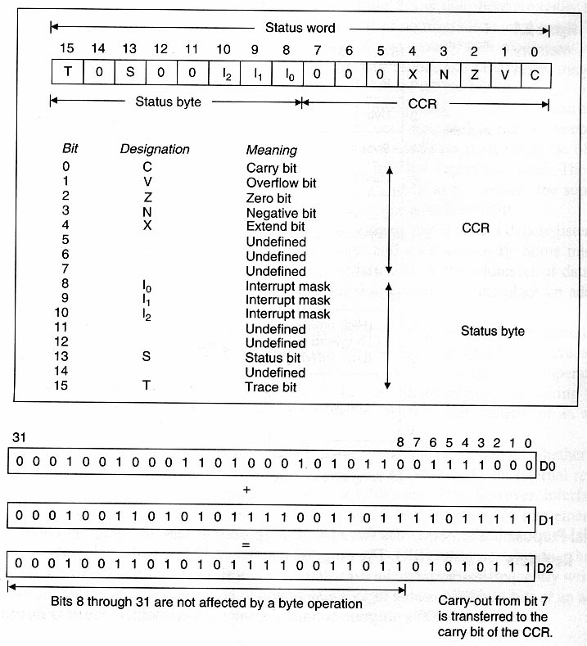
68000 Status Register

Slide 11
X-bit is identical to Carry bit and used only when a
byte/word/longword is extended beyond 8,16 or 32 bits.
During addition,subtraction,negation or shifting,X-bit reflects
the status of carry bit.
X bit is provided as C bit will be used as a multipurpose test
flag.(to transfer information between subroutines).
If C-bit is set following a return from subroutine,it denotes an
error occurred in sub-routine.
X bit is provided exclusively for arithmetic operations that
generates a true carry out.
Instrns like CMP,MOVE,AND,MUL,TST,CLR and DIV affect
the status of the carry bit but have no effect on X-bit

Slide 12
Addressing Modes

Slide 13
Register Transfer language(RTL)
Unambiguous notation to describe information manipulation
Registers are denoted by their names (eg. D0-D7, A0-A7)
Square brackets mean “the contents of”
Base number noted by a prefix (%-binary, $-hex)
Backward arrow indicates a transfer of information (←)
[D4] ← 50 Put 50 into register D4
[D4] ← $1234 Put $1234 into register D4
[D3] ← $FE 1234 Put $FE 1234 into register D3

Slide 14
ADD <source>,<destination>
[destination] ← [source] + [destination]
MOVE <source>,<destination>
[destination] ← [source]

Slide 15
1.Immediate Addressing
The operand will be part of the instruction.
Ex: MOVE.B #25,D2;move 25 to D2.
#→precedes the immediate operand and indicates to the assembler that the following value is to be used with the immediate addresing mode.
2.Absolute Addressing/Direct Addressing
Instrn contains the operand’s address.
Ex: MOV.L D3,$1234 ; [M($1234)]←[D3(16:31)]
[M($1236)]←[D3(0:15)]
MOV.W $1234,D3; [D3(0:15)]←[M($1234)]

Slide 16
3.Register Direct Addressing
-s/c or dstn. Operands are internal registers.
Ex:MOVE.L D0,D3; [D3]←[D0]
MOVE.W D0,D3; [D3(0:15)]←[D0(0:15)]
4.Address Register Indirect Addressing
-Addr of an operand is in a register.
-reg. is called a pointer reg and is one of addr reg.
Ex: MOVE.L (A0),D3 ; [D3] ←[M([A0])]
5.Addr Reg Indirect with PostIncrement Addressing
-E.A is generated as in the reg indirect,except that contents of
addr. Reg is incremented by 1,2,4 after the execution of the
instrn.
Ex: MOVE.L (A0)+,D3 ; [D3]←[M(A0)]
[A0]←[A0]+ 4

Slide 17
6.Addr Reg Indirect with Predecrement Addressing
Specifed addr. reg. is decremented before the exe of instrn.
Ex:MOVE.L –(A0),D3 ; [A0]←[A0]-4
[D3]←[M([A0])]
7.Register Indirect with Displacement Addressing
E.A is calculated by adding the contents of addr reg to 16-bit displacement word forming part of instrn.
Ex: MOVE.L 12(A4),D3 ; [D3]←[M(12+[A4])]
8.Reg Indirect with Index Addressing
-E.A is sum of contents of addr reg,general reg and displacement.
Ex: MOVE.L 9(A1,D0.W),D3; [D3]←[M(9+[A1]+[D0(0:15)])]

Slide 18
The 68000 Family Instruction Set
Groups of instructions:
Data movement
Arithmetic operations
Logical operations
Shift operations
Bit Manipulation
Program Control

Slide 19
Data Movement Operations
Copy information from source to destination
MOVE/MOVEA
MOVE to CCR MOVE <ea>,CCR – word instruction
MOVE to/from SR MOVE <ea>,SR – in supervisor mode only; MOVE #$2700,SR – sets the 68K in supervisor mode
MOVE USP – to/from User Stack Pointer MOVE.L USP,A3 - transfer the USP to A3
MOVEQ – Move Quick(8b #value to 32b reg)
MOVEM – to/from multiple registers (W/L) e.g., MOVEM.L D0-D5/A0-A5, -(A7) MOVEM.L (A7)+,D0-D5/A0-A5
MOVEP – Move Peripheral

Slide 20
Data Movement Operations, LEA
Calculates an effective address and loads it into an address register – LEA <ea>,An
Can be used only with 32-bit operands
Assembly language RTL
LEA $0010FFFF,A5 [A5] ← $0010FFFF Load the address $0010 FFFF into register A5.
LEA $12(A0,D4.L),A5 [A5] ← $12 + [A0] + [D4] Load contents of A0 plus contents of D4 plus $12 into A5.

Slide 21
Data Movement Operations, cont’d
PEA: Push Effective Address
Calculates an effective address and pushes it onto the stack pointed at by A7 – PEA <ea>
Can be used only with 32-bit operands
EXG (EXG Xi,Xj)
Exchanges the entire 32-bit contents of two registers
SWAP (SWAP Di)
Exchanges the upper- and lower-order words of a DATA register

Slide 22
Integer Arithmetic Operations
Float-point operations not directly supported
Except for division, multiplication, and if destination is Ai, all act on 8-, 16-, and 32-bit values
ADD/ADDA (no mem-to-mem additions, if destination of the result in Ai register, use ADDA)
ADDQ → add quick(adds a small 3-bit literal(constant) quickly)
ADDI→ Add Immediate (adds a literal value to the destination)
ADDX→ Add extended (adds also the contents of src loc to the content of dest plus X bit of the CCR)
CLR (clear specified data register or memory location)

Slide 23
Integer Arithmetic Operations, cont’d
DIVU/DIVS – unsigned/2’s-complement numbers
DIVU <ea>,Dn or DIVS <ea>,Dn
32-bit longword in Dn is divided by the 16-bit word at <ea>
16-bit quotient is deposited in the lower-order word of Dn
The remainder is stored in the upper-order word of Dn
MULU/MULS – unsigned/2’s-complement numbers
Low-order 16-bit word in Dn is multiplied by the 16-bit word at <ea>
32-bit product is deposited in Dn
SUB, SUBA, SUBQ, SUBI, SUBX
NEG – forms the 2’s complement of an operand NEG <ea>
NEGX – Negate with Extend, used for multi-prec. arith.
EXT – Sign Extend EXT.W Dn copies bit 7 to bits 8-15 EXT.L Dn copies bit 15 to bits 16-31

Slide 24
BCD Arithmetic Operations
Only 3 instructions support BCD
ABCD Di,Dj or ABCD –(Ai),-(Aj) Add BCD with extend – adds two packed BCD digits together with X bit from the CCR
SBCD – similar [destination]←[destination]-[source]-[X]
NBCD <ea> subtracts the specified operand from zero together with X bit and forms the 10’s complement of the operand if X =0, or 9’s complement if X =1
Involve X because they are intended to be used in operations on a string of BCD digits

Slide 25
Logical Operations
Standard AND, OR, EOR, and NOT
Immediate operand versions: ANDI, ORI, EORI
AND a bit with 0 – mask
OR a bit with 1 – set
EOR a bit with 1 – toggle
Logical operations affect the CCR in the same way as MOVE instructions

Slide 26
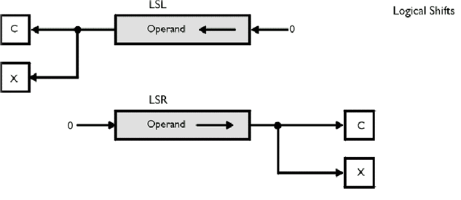
Shift Operations
Logical Shift
LSL – Logical Shift Left
LSR – Logical Shift Right

Slide 27
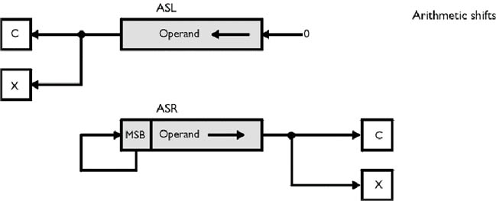
Arithmetic Shift ASL – Arithmetic Shift Left ASR – Arithmetic Shift Right

Slide 28
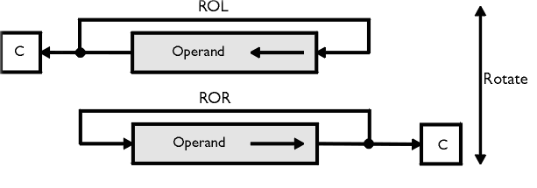
Rotate
ROL – Rotate Left
ROR – Rotate Right

Slide 29
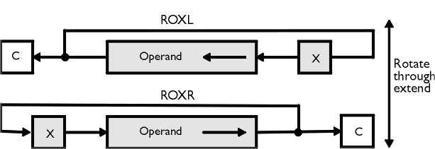
Rotate Through Extend
ROXL – Rotate Left Through Extend
ROXR – Rotate Right Through Extend

Slide 30
Effect of the Shift Instructions
After CCR After CCR
Initial Value First Shift XNZVC Second Shift XNZVC
ASL 11101011 11010110 11001 10101100 11001
ASL 01111110 11111100 01010 11111000 11011
ASR 11101011 11110101 11001 11111010 11001
ASR 01111110 00111111 00000 00011111 10001
LSL 11101011 11010110 11001 10101100 11001
LSL 01111110 11111100 01000 11111000 11001
LSR 11101011 01110101 10001 00111010 10001
LSR 01111110 00111111 00000 00011111 10001
ROL 11101011 11010111 ?1001 10101111 ?1001
ROL 01111110 11111100 ?1000 11111001 ?1001
ROR 11101011 11110101 ?1001 11111010 ?1001
ROR 01111110 00111111 ?0000 10011111 ?1001

Slide 31
Forms of Shift Operations
Mode 1 ASL Dx,Dy Shift Dy by Dx bits
Mode 2 ASL #<data>,Dy Shift Dy by #data bits
Mode 3 ASL <ea> Shift the contents at the effective address by one place
All three modes apply to all eight shift instructions

Slide 32
Bit Manipulation Operations
Act on a single bit of an operand:
The complement of the selected bit is moved to the Z bit (Z set if specified bit is zero)
The bit is either unchanged, set, cleared, or toggled
NVCX bits are not affected
May be applied to a bit within byte or longword
BTST – Bit Test only
BSET – Bit Test and Set (specified bit set)
BCLR – Bit Test and Clear (specified bit cleared)
BCHG – Bit Test and Change (specified bit toggled)

Slide 33
Bit Manipulation Operations, cont’d
All 4 have the same assembly language forms:
BTST Dn, <ea> or BTST #<data>,<ea>
Location of the bit to be tested
Effective address of the operand

Slide 34
Program Control Operations
Examine bits in CCR and chose between two courses of action
CCR bits are either:
Updated after certain instruction have been executed, or
Explicitly updated (bit test, compare, or test instructions)
Compare instructions: CMP, CMPA, CMPI, CMPM
Subtract the contents of one register (or mem. location) from another register (or mem. location)
Update NZVC bits of the CCR
X bit of the CCR is unaffected
The result of subtraction is ignored

Slide 35
Program Control Operations, cont’d
CMP: CMP <ea1>,<ea2> [<ea2>]-[<ea1>]
CMPI: CMP #<data>,<ea> comparison with a literal
CMPA: CMP <ea>,An used for addresses, operates only on word and longword operands
CMPM: CMP (Ai)+,(Aj)+ compares memory with memory, one of few that works only with operands located in memory
TST: TST <ea> zero is subtracted from specified operand; N and Z are set accordingly, V and C are cleared, X is unchanged
Except CMPA, all take byte, word, or longword operands

Slide 36
Program Control Operations, cont’d
Branch Instructions
Branch Conditionally
Branch Unconditionally
Test Condition, Decrement, and Branch
BRANCH CONDITIONALLY
Bcc <label>
cc stands for one of 14 logical conditions (Table 2.4)
Automatically calculated displacement can be d8 or d16
Displacement is 2’s complement signed number
8-bit displacement can be forced by adding .S extension
ZNCV bits are used to decide

Slide 37
Program Control Operations, cont’d
BRANCH UNCONDITIONALLY
BRA <label> or JMP (An) JMP d16(An) JMP d8(An,Xi) JMP Absolute_address JMP d16(PC) JMP d8(PC,Xi)
TEST CONDITION, DECREMENT, and BRANCH
DBcc Dn,<label> (16 bit displacement only)
One of 14 values from Table 2.4, plus T, plus F
If test is TRUE, branch is NOT taken !
If cc is NOT TRUE, Dn is decremented by 1; If Dn is now equal to –1 next instruction is executed if not, branch to <label is taken>

Slide 38
Miscellaneous Instructions
Scc: Set byte conditionally Scc <ea> (cc same as in DBcc) If the condition is TRUE, all the bits of the byte specified by <ea> are SET, if the condition is FALSE, bits are CLEARED
NOP: No Operation
RTS: Return from Subroutine
STOP: STOP #n Stop and load n into Status Register; n is 16-bit number; Privileged instruction

